Slide 1
COMPILER CONSTRUCTION LAB
By
Sindhuja.p

Slide 2
Course Code: GR22A3068 L/T/P/C :0/ 0/ 4/ 2
III Year I Semester
Course Outcomes:
1.Implement the techniques of Lexical Analyzer
2.Use lex to recognize token
3.Implement basic programs using yaac
4.Acquire practical knowledge on parsing
5.Implement three address code generation

Slide 3
LIST OF EXPERIMENTS:
TASK 1: Introduction to lex tools.
TASK 2: Lex program to count the number of words, characters, blank spaces and lines
TASK 3: LEX program to identify REAL PRECISION of the given number
TASK 4: LEX Program to recognize tokens
TASK 5: Implement a program to Elimination of Left Recursion in a grammar.
TASK 6: Program to implement Predictive Parsing.
TASK 7: Design LALR bottom-up parser for the above language.
TASK 8: Write program to generate machine code from the abstract syntax tree
generated by the parser
TASK 9: Introduction to YACC.

Slide 4
TASK 10: Convert the BNF rules into Yacc form and Write code to generate abstract
syntax tree.
TASK 11: YACC Program of an advanced desk calculator.
TASK 12: Program to Implement 3 Address Code.
Textbooks:
1.Compilers: Principles, Techniques and Tools, V. Aho, R. Sethi and J. Ullman.
2.lex&yacc – John R. Levine, Tony Mason, Doug Brown, O’reilly
References:
1.The Design and Evolution of C++, Bjarne Stroustrup.
2.Modern Compiler Design- Dick Grune, Henry E. Bal, Cariel T. H. Jacobs, Wileydre

Slide 5
Compiler :
A compiler is system software that translates the source program written in a high-level language into a low-level language.
The compilation process of source code is divided into several phases in order to ease the process of development and designing.
The phases work in sequence as the output of the previous phase is utilized in the next phase.
Phases of compiler:

Slide 6
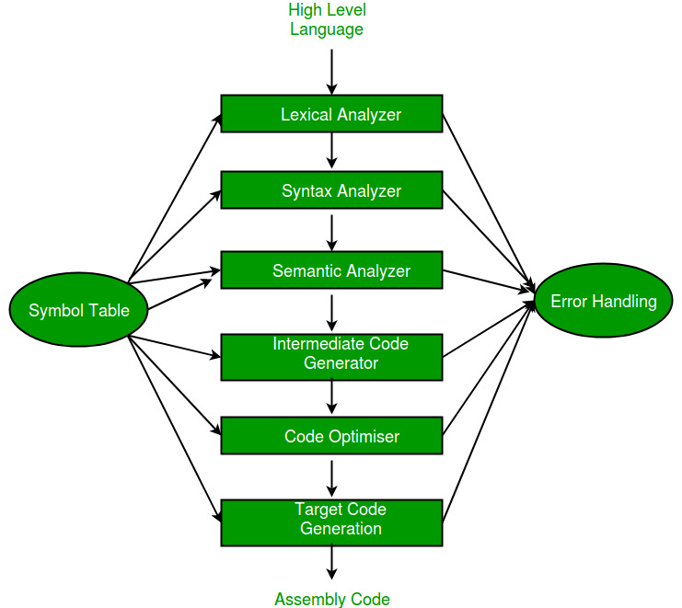

Slide 7
Lexical analysis :
It is the first step of compiler design, it takes the input as a stream of characters and gives the output as tokens also known as tokenization.
The tokens can be classified into identifiers, Sperators, Keywords, Operators, Constant and Special Characters.
It has three phases:
Tokenization: It takes the stream of characters and converts it into tokens.
Error Messages: It gives errors related to lexical analysis such as exceeding length, unmatched string, etc.
Eliminate Comments: Eliminates all the spaces, blank spaces, new lines, and indentations.

Slide 8
Token :
It is basically a sequence of characters that are treated as a unit as it cannot be further broken down. In programming languages like C language- keywords (int, char, float, const, goto, continue, etc.) identifiers (user-defined names), operators (+, -, *, /), delimiters/punctuators like comma (,), semicolon(;), braces ({ }), etc. , strings can be considered as tokens.
Example :
int a = 10; //Input Source code
Tokens
int (keyword), a(identifier), =(operator), 10(constant) and ;(punctuation-semicolon)
Total number of tokens=5

Slide 9
LEX TOOL
TASK 1: Introduction to lex tools.
Lex :
Lex is a tool or a computer program that generates Lexical Analyzers (converts the stream of characters into tokens). The Lex tool itself is a compiler. The Lex compiler takes the input and transforms that input into input patterns. It is commonly used with YACC(Yet Another Compiler Compiler). It was written by Mike Lesk and Eric Schmidt.

Slide 10
Function of Lex :
1. In the first step the source code which is in the Lex language having the file name ‘File.l’ gives as input to the Lex Compiler commonly known as Lex to get the output as lex.yy.c.
2. After that, the output lex.yy.c will be used as input to the C compiler which gives the output in the form of an ‘a.out’ file, and finally, the output file a.out will take the stream of character and generates tokens as output.
lex.yy.c: It is a C program.
File.l: It is a Lex source program
a.out: It is a Lexical analyzer

Slide 11
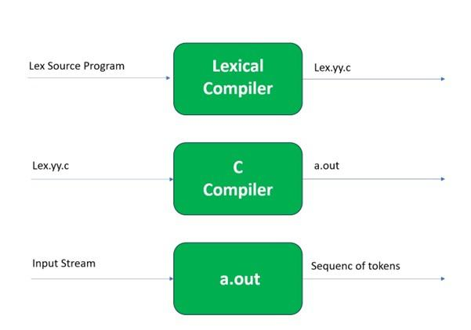

Slide 12
Lex File Format
A Lex program consists of three parts and is separated by %% delimiters:-
Declarations
%%
Translation rules
%%
Auxiliary procedures
Declarations: The declarations include declarations of variables.
Translation rules: These rules consist of Pattern and Action.
Auxiliary procedures: The Auxilary section holds auxiliary functions used in the actions.

Slide 13
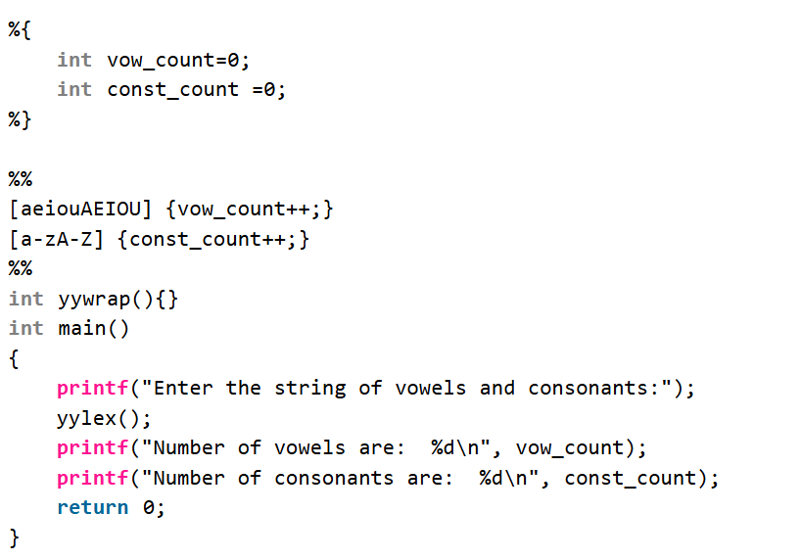

Slide 14
%{
#include<stdio.h>
int vow=0, con=0;
%}
%%
[ \t\n]+ ;
[aeiouAEIOU]+ {vow++;}
[a-zA-Z] {con++;}
%%

Slide 15
int main( )
{
printf("Enter some input string:\n");
yylex();
printf("Number of vowels=%d\n",vow);
printf("Number of consonants=%d\n",con);
}
int yywrap( )
{
return 1;
}

Slide 16
TASK 2: Lex program to count the number of words, characters, blank spaces and lines
%{
#include<stdio.h>
int sc=0,wc=0,lc=0,cc=0;
%}
%%
[\n] { lc++; cc+=yyleng;}
[ \t] { sc++; cc+=yyleng;}
[^\t\n ]+ { wc++; cc+=yyleng;}
%%

Slide 17
int main(int argc ,char* argv[ ]) // int main()
{
printf("Enter the input:\n");
yylex();
printf("The number of lines=%d\n",lc);
printf("The number of spaces=%d\n",sc);
printf("The number of words=%d\n",wc);
printf("The number of characters are=%d\n",cc);
}
int yywrap( )
{
return 1;
}

Slide 18
Then the scanner receives an end-of-file indication from YY_INPUT, it then checks the yywrap() function. If yywrap() returns false (zero), then it is assumed that the function has gone ahead and set up yyin to point to another input file, and scanning continues. If it returns true (non-zero), then the scanner terminates, returning 0 to its caller.

Slide 19
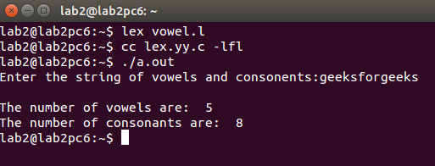

Slide 20
TASK 3: LEX program to identify REAL PRECISION of the given number
%{
#include<stdio.h>
%}
%%
[+-]?[0-9]+\.[0-9]{1,7}([eE][+-]?[0-9]+)? { printf("Single Precision Real Number\n"); }
[+-]?[0-9]+\.[0-9]{8,16}([eE][+-]?[0-9]+)? { printf("Double Precision Real Number\n"); }
[+-]?[0-9]+\.([eE][+-]?[0-9]+)? { printf("Real Number with No Fractional Part\n"); }
[+-]?[0-9]+ { printf("Integer Number\n"); }
%%

Slide 21
int main()
{
printf("Enter a number: ");
yylex();
return 0;
}
int yywrap()
{
return 1;
}

Slide 22
TASK 4: LEX Program to recognize tokens
%{
/* C code section - includes standard libraries */
#include <stdio.h>
%}
/* Definitions */
DIGIT [0-9]
LETTER [a-zA-Z]
ID {LETTER}({LETTER}|{DIGIT})*

Slide 23
%%
/* Rules section */
"if" { printf("KEYWORD: if\n"); }
"else" { printf("KEYWORD: else\n"); }
"for" { printf("KEYWORD: for\n"); }
{ID} { printf("IDENTIFIER: %s\n", yytext); }
{DIGIT}+ { printf("NUMBER: %s\n", yytext); }
"+" { printf("OPERATOR: +\n"); }
"-" { printf("OPERATOR: -\n"); }
"*" { printf("OPERATOR: *\n"); }
"/" { printf("OPERATOR: /\n"); }
"=" { printf("OPERATOR: =\n"); }
\n|\t| " " { /* Ignore whitespace */ }
. { printf("UNKNOWN TOKEN: %s\n", yytext); }
%%

Slide 24
/* C code section */
int main() {
yylex(); // Call the lexical analyzer
return 0;
}
int yywrap() {
return 1;
}

Slide 25
TASK 5: Implement a program to Elimination of Left Recursion in a grammar.
%{
#include <stdio.h>
#include <string.h>
void eliminate_left_recursion(char* non_terminal, char* alpha, char* beta);
%}

Slide 26
%%
// Rule to match a non-terminal followed by "->"
[A-Z] "->" {
char non_terminal[2];
non_terminal[0] = yytext[0]; // Store the non-terminal
non_terminal[1] = '\0'; // Null-terminate the string
// Prompt user to enter production rules for the non-terminal
printf("Enter production for %s (format: α | β): ", non_terminal);
char input[100], alpha[50], beta[50];
fgets(input, sizeof(input), stdin);
// Split input at the '|'
sscanf(input, "%[^|]|%s", alpha, beta);

Slide 27
// Call function to eliminate left recursion
eliminate_left_recursion(non_terminal, alpha, beta);
}
// Rule to ignore any other inputs
. { /* Ignore other inputs */ }
%%

Slide 28
// Function to eliminate left recursion from the given productions
void eliminate_left_recursion(char* non_terminal, char* alpha, char* beta) {
printf("Original Production: %s -> %s%s | %s\n", non_terminal, non_terminal, alpha, beta);
char new_non_terminal[3];
snprintf(new_non_terminal, sizeof(new_non_terminal), "%s'", non_terminal); // Create new non-terminal
// Print the transformed productions
printf("After removing left recursion:\n");
printf("%s -> %s%s\n", non_terminal, beta, new_non_terminal); // Non-left-recursive rule
printf("%s -> %s%s | ε\n", new_non_terminal, alpha, new_non_terminal); // Left-recursive rule
}

Slide 29
int main() {
printf("Enter grammar productions (terminate with CTRL+D):\n");
yylex(); // Start the lexical analysis
return 0;
}
Output:A->Aa|b
A->bA’
A’->aA’|ε

Slide 30
TASK 6: Program to implement Predictive Parsing.
#include <stdio.h>
#include <ctype.h> // for isdigit function
#include<stdlib.h>
char input[100];
Int pos = 0; char lookahead;
// Function prototypes for recursive descent parsing
void E();
void Eprime();
void T();
void Tprime();
void F();
void match(char t);

Slide 31
// Helper function to get the next character char nextToken()
{
return input[pos++];
}
// Function to report a syntax error
void syntaxError()
{
printf("Syntax Error!\n");
exit(1);
}

Slide 32
// Function to match a token and advance the input
void match(char t)
{
if (lookahead == t)
{
lookahead = nextToken();
}
Else
{
syntaxError();
}
}

Slide 33
// Production: E → T E’
void E() {
T();
Eprime(); }
// Production:E' → + T E' | ε
void Eprime() {
if (lookahead == '+’)
{
match('+’);
T(); Eprime();
}
// E' → ε (epsilon, do nothing)
}

Slide 34
// Production: T → F T’
void T() {
F();
Tprime(); }
// Production: T' → * F T' | ε
void Tprime() {
if (lookahead == '*’) {
match('*’);
F(); Tprime(); }
// T' → ε (epsilon, do nothing)
}

Slide 35
// Production: F → ( E ) | id
void F() {
if (lookahead == '(') {
match('(‘);
E(); match(')'); }
else if (isalnum(lookahead)) {
// For simplicity, we treat 'id' as a single character match(lookahead);
}
else {
syntaxError();
} }

Slide 36
int main() {
printf("Enter an arithmetic expression: ");
scanf("%s", input);
lookahead = nextToken();
// Start parsing from the start symbol E
E();
// Ensure entire input is consumed
if (lookahead == '\0') {
printf("Parsing successful!\n"); }
else { syntaxError(); }
return 0; }
Output:enter an arithmetic expression:i+i*i
Parsing sucessful

Slide 37
TASK 7: Design LALR bottom-up parser for the above language.
// Terminals
T_NUM // Represents numeric values (integer numbers)
T_PLUS // Represents the '+' operator
T_MULTIPLY // Represents the '*' operator
T_LPAREN // Represents '('
T_RPAREN // Represents ')'
T_END // End of input
// Non-terminals
Expression // Represents an expression
Term // Represents a term in the expression
Factor // Represents a factor, which could be a number or a sub-expression

Slide 38
// Grammar Rules
Expression -> Expression T_PLUS Term // Rule 1: Addition in an expression
Expression -> Term // Rule 2: Expression reduces to a Term
Term -> Term T_MULTIPLY Factor // Rule 3: Multiplication in a term
Term -> Factor // Rule 4: Term reduces to a Factor
Factor -> T_NUM // Rule 5: Factor reduces to a number
Factor -> T_LPAREN Expression T_RPAREN // Rule 6: Parenthesized expression

Slide 39
TASK 7: Design LALR bottom-up parser for the above language.
#include <stdio.h>
#include <stdlib.h>
#include <ctype.h>
// Token definitions
typedef enum {
T_NUM = 256,
T_PLUS,
T_MULTIPLY,
T_LPAREN,
T_RPAREN,

Slide 40
T_END
} TokenType;
// Token structure
typedef struct {
TokenType type;
int value;
} Token;
// Parse stack structure
typedef struct {
int state;
int value;
} StackEntry;

Slide 41
#define STACK_MAX 100
StackEntry stack[STACK_MAX];
int stackTop = -1;
// Functions to manipulate the parse stack
void push(int state, int value) {
if (stackTop < STACK_MAX - 1) {
stack[++stackTop].state = state;
stack[stackTop].value = value;
} else {
printf("Stack overflow\n");
exit(1);
}}

Slide 42
void pop(int count) {
if (stackTop >= count - 1) {
stackTop -= count;
} else {
printf("Stack underflow\n");
exit(1);
}
}
// Lexer function to return next token from input
Token getToken(const char **input) {
while (**input == ' ') (*input)++;
if (isdigit(**input)) {
Token token = { T_NUM, 0 };

Slide 43
while (isdigit(**input)) {
token.value = token.value * 10 + (**input - '0');
(*input)++;
}
return token;
} else if (**input == '+') {
(*input)++;
return (Token) { T_PLUS, 0 };
} else if (**input == '*') {
(*input)++;
return (Token) { T_MULTIPLY, 0 };
} else if (**input == '(') {

Slide 44
(*input)++;
return (Token) { T_LPAREN, 0 };
} else if (**input == ')') {
(*input)++;
return (Token) { T_RPAREN, 0 };
} else if (**input == '\0') {
return (Token) { T_END, 0 };
} else {
printf("Unknown character: %c\n", **input);
exit(1);
}
}

Slide 45
// A simplified parse table (hardcoded for this example)
int parseTable[5][6] = {
{1, -1, -1, 2, -1, -1}, // state 0
{-1, 3, -1, -1, -1, 0}, // state 1
{1, -1, -1, 2, -1, -1}, // state 2
{-1, -1, 4, -1, -1, -1}, // state 3
{-1, -1, -1, -1, -1, -2} // state 4 (accept state)
};

Slide 46
// Reduced production actions
void reduce(int rule) {
if (rule == 0) { // expression -> expression + term
int term = stack[stackTop].value;
pop(3);
stack[stackTop].value += term;
} else if (rule == 1) { // term -> term * factor
int factor = stack[stackTop].value;
pop(3);
stack[stackTop].value *= factor;
}
}

Slide 47
// Main parse function
void parse(const char *input) {
stackTop = -1;
push(0, 0); // Start state
Token token = getToken(&input);
while (1) {
int state = stack[stackTop].state;
int action = parseTable[state][token.type - T_NUM];
if (action > 0) { // Shift action
push(action, token.value);
token = getToken(&input);
}

Slide 48
else if (action < 0) { // Reduce action
if (action == -2) { // Accept
printf("Result: %d\n", stack[stackTop].value);
break;
}
reduce(-action - 1);
} else {
printf("Syntax error\n");
break;
}
}
}

Slide 49
// Main function to take input and call the parser
int main() {
const char *input = "3 + 5 * 2";
printf("Parsing: %s\n", input);
parse(input);
return 0;
}

Slide 50
TASK 8: Write program to generate machine code from the abstract syntax tree
generated by the parser
#include <stdio.h>
#include <stdlib.h>
#include <string.h>
// Define the structure for AST nodes
typedef struct ASTNode {
char value; // Operator (+, -, *, /) or operand (0-9)
struct ASTNode *left; // Left child
struct ASTNode *right; // Right child
} ASTNode;
int temp_count = 0; // Counter for temporary registers

Slide 51
// Function to create a new AST node
ASTNode* createNode(char value, ASTNode* left, ASTNode* right) {
ASTNode* node = (ASTNode*)malloc(sizeof(ASTNode));
node->value = value;
node->left = left;
node->right = right;
return node;
}
// Function to generate a unique temporary register name
void newTemp(char *temp) {
sprintf(temp, "R%d", temp_count++);
}

Slide 52
// Recursive function to generate machine code from the AST
void generateCode(ASTNode* node) {
char leftTemp[5], rightTemp[5], resultTemp[5];
// If the node is NULL, return
if (node == NULL)
return;
// Leaf node: if both children are NULL, it's an operand
if (node->left == NULL && node->right == NULL) {
return;
}

Slide 53
// Recursive code generation for left and right subtrees
generateCode(node->left);
newTemp(leftTemp);
printf("MOV %s, %c\n", leftTemp, node->left->value);
generateCode(node->right);
newTemp(rightTemp);
printf("MOV %s, %c\n", rightTemp, node->right->value);
// Generate a new temporary for the result
newTemp(resultTemp);

Slide 54
// Generate machine code based on the operation
switch (node->value) {
case '+':
printf("MOV %s, %s\n", resultTemp, leftTemp);
printf("ADD %s, %s\n", resultTemp, rightTemp);
break;
case '-':
printf("MOV %s, %s\n", resultTemp, leftTemp);
printf("SUB %s, %s\n", resultTemp, rightTemp);
break;

Slide 55
case '*':
printf("MOV %s, %s\n", resultTemp, leftTemp);
printf("MUL %s, %s\n", resultTemp, rightTemp);
break;
case '/':
printf("MOV %s, %s\n", resultTemp, leftTemp);
printf("DIV %s, %s\n", resultTemp, rightTemp);
break;
default:
printf("Unsupported operation\n");
return;
}node->value=‘A’;
}

Slide 56
// Main function to demonstrate the code generation
int main() {
// Constructing an example AST for the expression (3 + 5) * (10 - 2)
ASTNode* ast = createNode('*',
createNode('+', createNode('3', NULL, NULL), createNode('5', NULL, NULL)),
createNode('-', createNode(‘4', NULL, NULL), createNode('2', NULL, NULL)));
printf("Generated Machine Code:\n");
generateCode(ast);

Slide 57
// Free memory
free(ast->left->left);
free(ast->left->right);
free(ast->left);
free(ast->right->left);
free(ast->right->right);
free(ast->right);
free(ast);
return 0;
}

Slide 58
TASK :9 Introduction to YACC.
YACC (Yet Another Compiler Compiler) :
is a tool used in the process of compiler construction.
It simplifies the creation of parsers by allowing developers to specify the grammar of a programming language or other structured text format in a high-level, declarative way.
YACC is widely used in systems programming and is particularly useful for designing interpreters and compilers.

Slide 59
Grammar Specification: YACC uses context-free grammars, typically written in Backus-Naur Form (BNF), to define the syntax rules of a language.
LALR(1) Parsing: It generates parsers based on the Look-Ahead Left-to-Right parsing method for context-free grammars. This allows efficient parsing of a wide variety of languages.
C Code Integration: The actions for each rule in the grammar can include C code, enabling the parser to perform computations or build data structures during parsing.
Flexibility and Compatibility: YACC works seamlessly with LEX, a lexical analyzer generator. Together, they form a powerful pair for compiler design.

Slide 60
Structure :
%{
/* C code or declarations to include in the generated parser */
%}
%token TOKEN_NAME /* Token declarations */
%start START_SYMBOL /* Optional: Specify the start symbol */
%%
/* Grammar rules and associated actions */
non_terminal : production1 { action1 }
| production2 { action2 }
;
%%
/* Additional C code for helper functions, main(), or global variables */

Slide 61
Declarations Section (%{ ... %}):
Enclosed between %{ and %}, this section includes C code, such as #include directives, macro definitions, or global declarations.
Example:
%{
#include <stdio.h>
int yylex(); // Function prototype for lexical analyzer
void yyerror(const char *s); // Error-handling function
%}

Slide 62
Token Declarations (%token):
Tokens (terminal symbols) are declared here, typically corresponding to input symbols provided by the lexer (e.g., keywords, operators).
Example:
%token NUMBER PLUS MINUS MULTIPLY DIVIDE
Precedence and Associativity (%left, %right, %nonassoc):
Defines operator precedence and associativity to resolve parsing conflicts (e.g., shift/reduce conflicts).
Example :
%left '+' '-'
%left '*' '/'

Slide 63
Start Symbol (%start):
Specifies the starting non-terminal of the grammar. If omitted, the first rule's left-hand side is the default start symbol.
Example :
%start expr
Rules Section (%%):
Contains the grammar rules that define the structure of the language.
Each rule has the following format:
non_terminal : production1 { C action code }
| production2 { C action code }
;

Slide 64
non_terminal: The left-hand side of the rule (a non-terminal symbol).
production1: Right-hand side of the rule (sequence of terminals and non-terminals).
{ C action code }: Embedded C code to execute when the rule is applied (optional).

Slide 65
Example :
expr : expr '+' term { printf("Addition\n"); }
| expr '-' term { printf("Subtraction\n"); }
| term
;
term : term '*' factor { printf("Multiplication\n"); }
| term '/' factor { printf("Division\n"); }
| factor
;
factor : '(' expr ')' { }
| NUMBER { printf("Number: %d\n", $1); }
;

Slide 66
C Code Section (After %%)
Contains any additional C code needed for the program, such as:
The main() function.
The yyerror() function for error handling.
Supporting functions or global variable definitions.
Example :
%%
int main() {
printf("Enter an expression:\n");
yyparse();
return 0;
}
void yyerror(const char *s) {
fprintf(stderr, "Error: %s\n", s);
}

Slide 67
Special Symbols in YACC:
$n: Refers to the value of the n-th symbol in the production (1-based index).
Example :
expr : expr '+' term { $$ = $1 + $3; }
Here, $1 refers to the value of expr,
$3 refers to term, and $$ stores the result of the rule.
$$: Represents the value of the left-hand side of the rule.
%%: Separates sections in a YACC file.

Slide 68
Example YACC Syntax :
This YACC file parses arithmetic expressions and evaluates their result:
%{
#include <stdio.h>
#include <stdlib.h>
%}
%token NUMBER
%left '+' '-'
%left '*' '/'
%%
expr : expr '+' expr { $$ = $1 + $3; }
| expr '-' expr { $$ = $1 - $3; }
| expr '*' expr { $$ = $1 * $3; }
| expr '/' expr { if ($3 == 0) { yyerror("Division by zero"); exit(1); } else $$ = $1 / $3; }

Slide 69
| '(' expr ')' { $$ = $2; }
| NUMBER { $$ = $1; }
;
%%
int main() {
printf("Enter an expression:\n");
yyparse();
return 0;
}
void yyerror(const char *s) {
fprintf(stderr, "Error: %s\n", s);
}

Slide 70
TASK 10: Convert the BNF rules into Yacc form and Write code to generate abstract
syntax tree.
BNF RULES:
expr ::= term ('+' term | '-' term)*
term ::= factor ('*' factor | '/' factor)*
factor ::= '(' expr ')' | NUM
INPUT :(5 + 3) * 2

Slide 71
//Parser.y
%{
#include <stdio.h>
#include <stdlib.h>
// Define the AST node structure
typedef struct ASTNode {
char *type;
union {
int value; // For NUM
struct { // For operators
struct ASTNode *left;
struct ASTNode *right;
} operands;
} data;
} ASTNode;
// Function prototypes for creating AST nodes
ASTNode *create_num_node(int value);
ASTNode *create_op_node(char *type, ASTNode *left, ASTNode *right);
%}

Slide 72
%token NUM
%left '+' '-'
%left '*' '/'
%%
expr: term
| expr '+' term { $$ = create_op_node("+", $1, $3); }
| expr '-' term { $$ = create_op_node("-", $1, $3); }
;
term: factor
| term '*' factor { $$ = create_op_node("*", $1, $3); }
| term '/' factor { $$ = create_op_node("/", $1, $3); }
;
factor: '(' expr ')' { $$ = $2; }
| NUM { $$ = create_num_node($1); }
;
%%

Slide 73
// Create a number node
ASTNode *create_num_node(int value) {
ASTNode *node = (ASTNode *)malloc(sizeof(ASTNode));
node->type = "NUM";
node->data.value = value;
return node;
}
// Create an operator node
ASTNode *create_op_node(char *type, ASTNode *left, ASTNode *right) {
ASTNode *node = (ASTNode *)malloc(sizeof(ASTNode));
node->type = type;
node->data.operands.left = left;
node->data.operands.right = right;
return node;
}

Slide 74
// Main function and helper code
int main() {
printf("Enter expression: ");
yyparse();
return 0;
}
void yyerror(const char *s) {
fprintf(stderr, "Error: %s\n", s);
}

Slide 75
// lex file Lexer.l
%{
#include "y.tab.h"
%}
%%
[0-9]+ { yylval = atoi(yytext); return NUM; }
[ \t]+ { /* Ignore whitespace */ }
\n { return '\n'; }
. { return yytext[0]; } /* Match single characters */
%%

Slide 76
Installation and execution :
For Ubuntu/Debian:
sudo apt-get install bison flex gcc
Generate Parser Code:
yacc -d parser.y
This creates two files:
y.tab.c: Contains the parser code.
y.tab.h: Contains token definitions.
Generate Lexer Code:
lex lexer.l
This creates the file:
lex.yy.c: Contains the lexer code.
Compile the ProgramCombine the generated files (y.tab.c and lex.yy.c) and compile them using gcc:
gcc -o ast y.tab.c lex.yy.c -lm
Here:
-o ast: Specifies the output executable file as ast
.-lm: Links the math library (optional here but useful for advanced math functions).

Slide 77
Run the Program
Run the compiled executable:
./ast
Test Input
Enter arithmetic expressions when prompted. For example:
Enter an expression: (5 + 3) * 2
Output:abstract syntax tree

